Slide 1
Bringing it All Together
Lecture 12

Slide 2
Table of Contents
Learning Objectives.
Business Model Canvas: Desirability.
Business Model Canvas Template: Desirability.
Business Model Canvas: Feasibility.
Business Model Canvas Template: Feasibility.
Business Model Canvas: Viability.
Business Model Canvas Template: Viability.
Assessing Level of Readiness.
External Supports for Small Businesses in Ireland.
Key Takeaways.

Slide 3
Learning Objectives
Recap the learnings from this course.
Finalise your business model canvas template.
Reflect on level of readiness for self-employment.
Understand the external supports available to small businesses.
Notes:
Recap the main learnings from this course.
Finalise your business model canvas template.
Reflect on level of readiness for self-employment and next steps to take.
Understand the external supports available to set up a small business in Ireland.

Slide 4
Business Model Canvas: Desirability
Value Proposition.
What is the unique selling point of your product/service?
Customer Segments.
For whom are you creating value?
Customer Relationships.
What type of relationship should you have with customers?
Customer Channels.
How will your product or service reach the market?
Notes:
Value Proposition – What is the unique selling point of your product or service? How is your offering different (better) than competitors?
Customer Segments - For whom are you creating value?​ Who are your most important customers?
Customer Relationships – What type of relationship should you have with each customer segment? How will you get, keep and grow your customer base?
Customer Channels – How will your product or service reach the market? How will you communicate with customers?
Ensure you fill out these four sections of the Business Model Canvas – only a few words outlining the main elements from each.

Slide 5
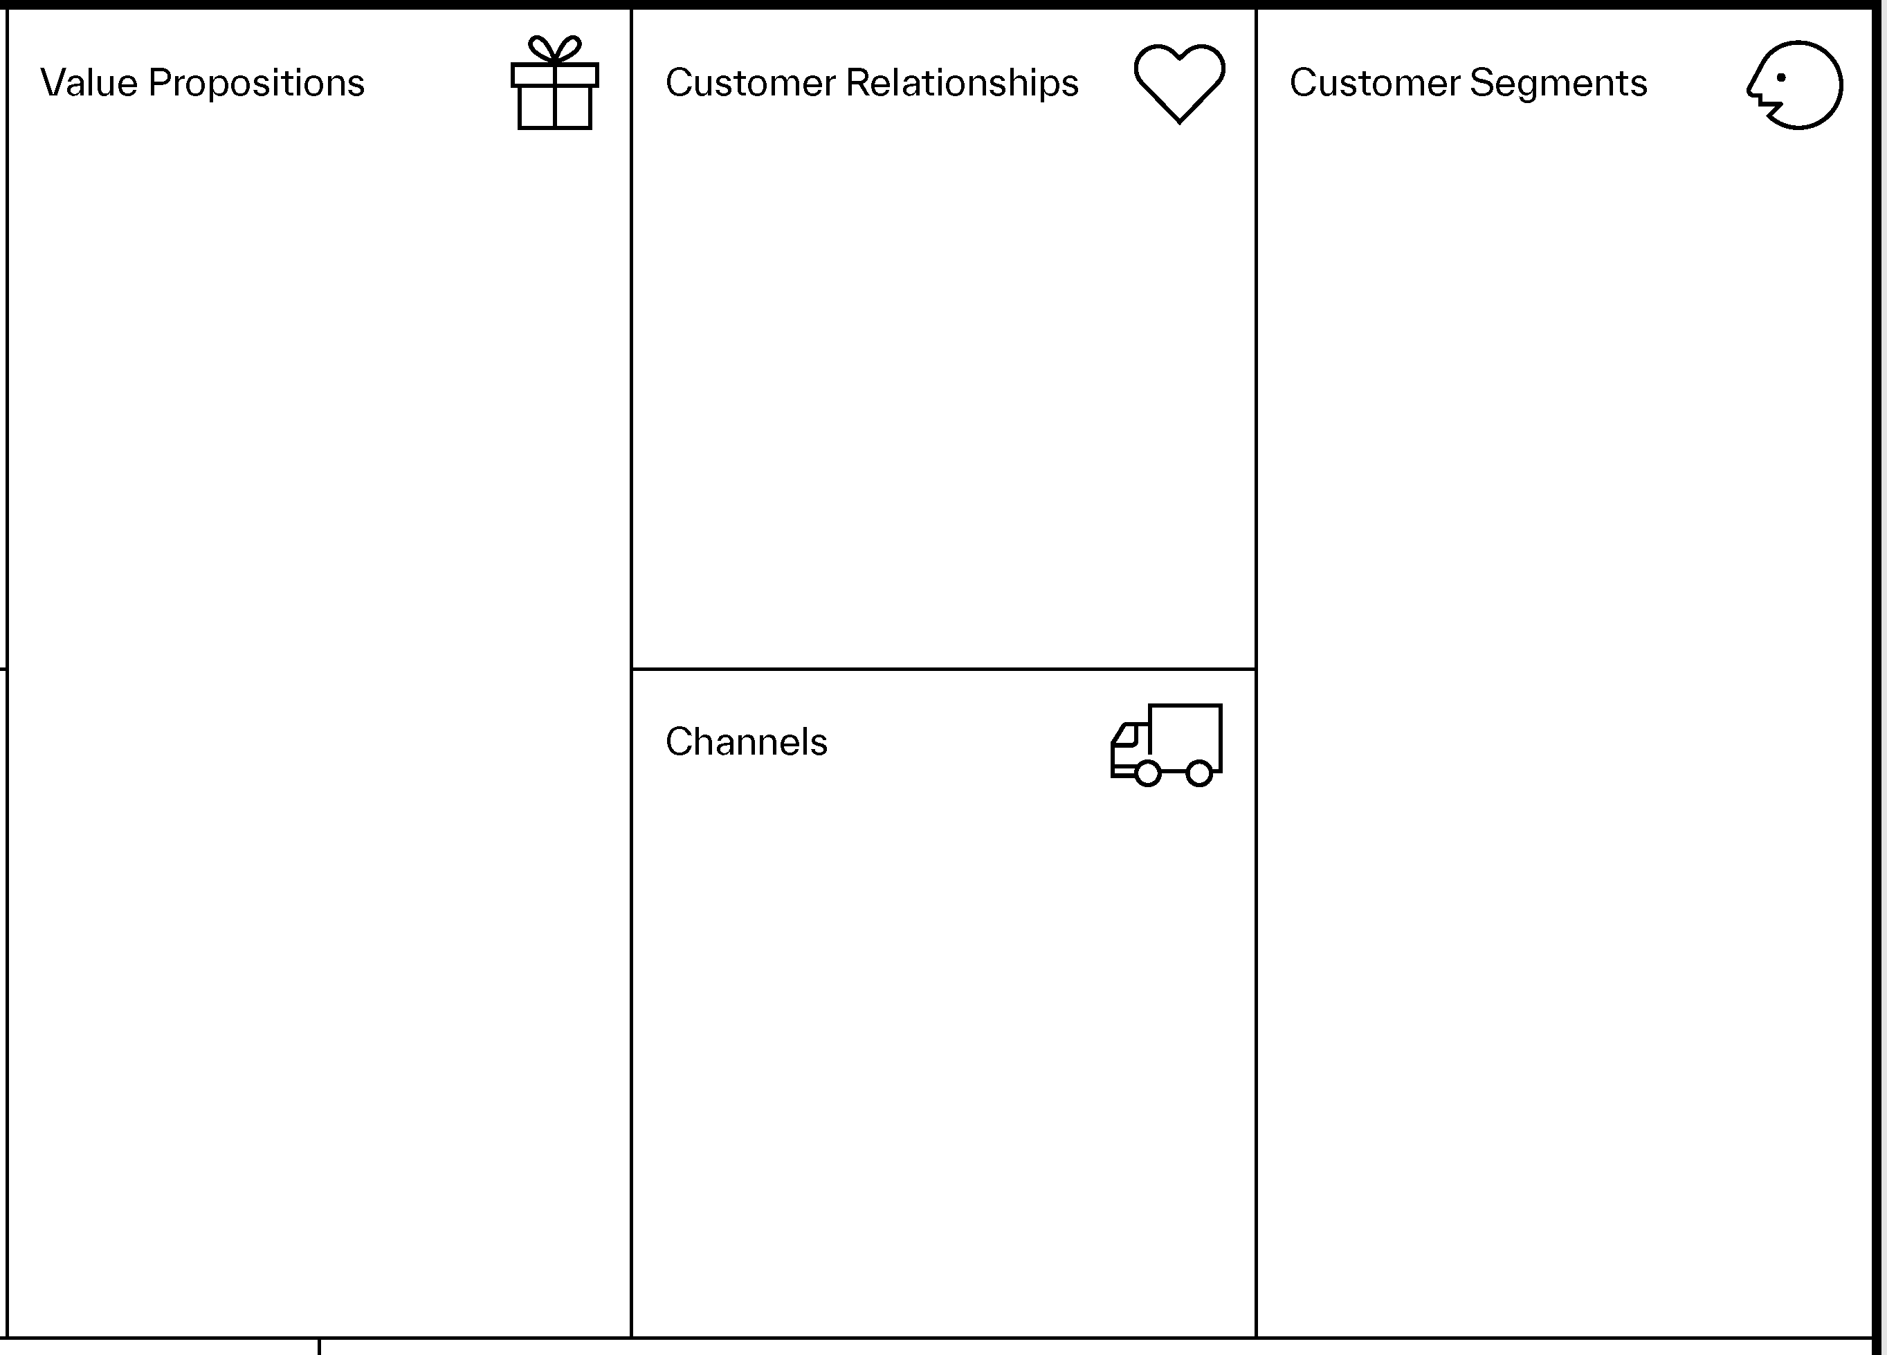
Business Model Canvas Template - Desirability
Notes:
Ensure you fill out these four sections of the Business Model Canvas – only a few words outlining the main elements from each.

Slide 6
Business Model Canvas: Feasibility
Key Partners.
Who are your key partners or those that you need to build and deliver your product/service?
Key Activities.
What key activities are needed to make your venture work?
Key Resources.
What physical, human, intellectual and financial resources do you require to make your business work?
Notes:
Key Partners – Who are your key partners or those you need to build and deliver your product or service?
Key Activities – What key activities are needed to make your venture work?
Key Resources – What physical, human, intellectual and financial resources do you require to make your business work?

Slide 7
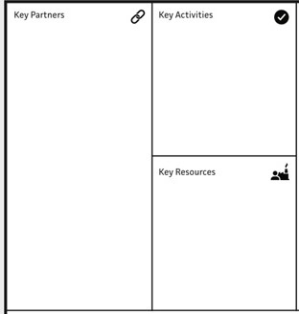
Business Model Canvas Template - Feasibility
Notes:
Ensure you fill out these three sections of the Business Model Canvas – only a few words outlining the main elements from each.

Slide 8
Business Model Canvas: Viability
Cost Structure.
What will it cost to operate the business and deliver value to customers? What are your fixed and variable costs?
Revenue Streams.
How will you capture revenue from sales of your product or service?
Notes:
Cost Structure – What will it cost to operate the business and deliver value to customers? What are your fixed and variable costs?
Revenue Streams – How will you capture revenue from sales of your product or service?

Slide 9
Business Model Canvas Template - Viability
Notes:
Ensure you fill out these two sections of the Business Model Canvas – only a few words outlining the main elements from each.

Slide 10
Assessing Level of Readiness
Why are you the best person to turn this venture into reality?
What skills, resources and experience do you bring?
What gaps in skills, resources and experience remain and how might you plug those gaps?
Might you consider bringing on board others to run the venture?
Who do you have available as an advisor or mentor? What experience, skills and resources do they provide?
What is your timeline for setting up a business? For instance, I intend to start now, within the next 6 months, the next year or over a year.

Slide 11
External Supports for Small Businesses in Ireland
Local Enterprise Office (LEO).
Enterprise Ireland (if business has export potential).
Government: https://supportingsmes.gov.ie/ .
Microfinance Ireland.
Skillnet Ireland.
InterTrade Ireland.
Chambers Ireland.
Small Firms Association.

Slide 12
Key Takeaways
The Business Model Canvas provides you with an initial plan for your business.
Ensure to assess your own level of readiness for entrepreneurship.
Familiarise with the agencies and organisations that offer small business support.
Notes:
The Business Model Canvas provides you with an initial plan for your business and needs to be regularly reviewed.
Assess your level of readiness both in terms of your own skills, resources and experience and the availability of support from a team and/or business mentor/advisor.
Familiarise yourself with the agencies and organisations that provide support to small businesses as they may offer a vital source of guidance, networking, mentorship, partnership and funding.

