Slide 1
Idea Generation and Evaluation
Lecture 2

Slide 2
Table of Contents 1 of 4
Learning Objectives
Idea Generation Exercise
Exercise Reflection
Methods for Generating Business Ideas
UN Sustainability Development Goals
What Customers Buy

Slide 3
Table of Contents 2 of 4
Sources of Business Ideas
Questions for Evaluating an Idea 1 of 2
Questions for Evaluating an Idea 2 of 2
What is a Business Idea?
What is a Business Opportunity?
Video Explainer – Ideas vs Opportunities
Common Pitfalls to Idea Generation

Slide 4
Table of Contents 3 of 4
Assignment Brief 1 of 3
Assignment Brief 2 of 3
Assignment Brief 3 of 3
Using SimVenture Validate
Business Model Canvas – Desirability
Business Model Canvas – Feasibility
Business Model Canvas – Viability

Slide 5
Table of Contents 4 of 4
Sim Venture Validate Process
Six Steps to Generate Business Ideas
Key Takeaways

Slide 6
Learning Objectives
Understand how to generate a business idea.
Know how to evaluate a business idea.
Recognise how an opportunity differs from an idea.
Learn to navigate Sim Venture Validate.
Notes:
Explain the different methods available for generating business ideas.
Identify the key questions to ask when evaluating your business idea.
Understand how an opportunity differs from an idea.
Familiarise with the Assignment 1 brief.
Learn to navigate Sim Venture Validate.

Slide 7
Idea Generation Exercise
Let’s do a five-minute exercise.
By law, all houses must be painted green.​
Think of new businesses to set up.
Be as creative as you like.
Three ideas (min.) and six ideas (max.). ​
Rate ideas from strongest (1) to weakest (6).​
Select your final top idea.
Notes:
Let’s do a five minute exercise in generating ideas.
A law has been passed that the outside walls of all houses must be painted green.
Think of businesses (products or services) that could be set up in response to this new law.
Write down min. of three ideas and max. of six.
Rate your business ideas - strongest (1) to weakest (6).
Select your final top idea.

Slide 8
Exercise Reflection
Some common examples include:​
green paint. ​
rollers, brushes and ladders.​
Some less common examples: ​
window fittings, blinds and doorframes.
roof slates, and floodlights.
gravel, chippings or decking.
Notes:
Some common examples include:​
green paint ​
rollers, brushes and ladders​
Some less common examples: ​
window fittings, blinds, doorframes, roof slates, and floodlights to differentiate one house from another. ​
gravel, chippings or decking rather than grass that blends in with the house.

Slide 9
Methods for Generating Business Ideas
Direct search.
Technological innovation.
Exploratory customer studies.
Facilitating lead user analysis.
Creative methods.
National policy.
Alliances / acquisitions / licenses.

Slide 10
UN Sustainability Development Goals

Slide 11
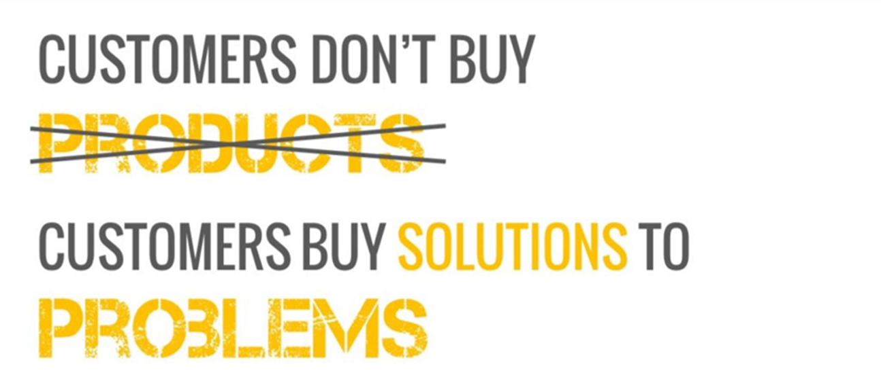
What Customers Buy

Slide 12
Sources of Business Ideas
Existing businesses.
Franchises.
Product licensing.
Work experience.
Patents.
Networks.
Support agencies.
Internet.
Hobbies.
Businesses for Sale.
Travel abroad.
Skills and Training.

Slide 13
Questions for Evaluating an Idea 1 of 2
Does the idea meet a real need or desire?
What’s new or different about the idea?
Who are the customers likely to be?
What do you offer that no one else does?
How much are they willing to pay?
Who are your competitors?
What’s the unique selling point of your idea?

Slide 14
Questions for Evaluating an Idea 2 of 2
What’s the biggest weakness?
What will be the biggest challenge you face in turning your idea into a reality?
How long will it take to get the company set-up?
Is this idea scalable, meaning can you provide more to meet demand, and if so, how?
Is this something you really want to do?

Slide 15
What is a Business Idea?
Inventors come up with new ideas.
Entrepreneurs are innovators who commercialise ideas.
Have to shift from the idea to assessing its desirability and feasibility as an opportunity.

Slide 16
What is a Business Opportunity?
You can build it and get it into the market.
Customers will buy it.
There are not too many competitors.
You can make a profit from it.
There’s a gap in the market, but is there a market in the gap?
Notes:
You can build it and get it into the market.
Customers will buy it.
There are not too many competitors.
You can make a profit from it
There’s a gap in the market, but is there a market in the gap?

Slide 17
Video Explainer – Ideas vs Opportunities Source: Alanis Business Academy, Youtube
Notes:
https://www.youtube.com/watch?v=Yi1N_fd_N7k

Slide 18
Common Pitfalls to Idea Generation
Assuming an idea is the same as an opportunity.
Judging ideas too quickly.
Sticking with first good idea without developing it.
Obeying rules that don’t exist rather than questioning assumptions.
Notes:
Assuming that a good idea is necessarily a good business opportunity.
Judging your ideas too quickly without critically raising questions and queries.
Sticking with your first good idea rather than developing it substantially.
Obeying rules that don’t exist rather than questioning and examining your assumptions and testing them.

Slide 19
Assignment Brief (1 of 3)
Designing your business idea video:
Problem.
Solution.
Storyboard your video.
Maximum duration of video is 120 seconds.

Slide 20
Assignment Brief (2 of 3)
Requirements:
Introduces you, the entrepreneur.
Clearly defines the business proposition/business idea.
Explains the problem it solves and how it works.
Highlights how the idea is innovative.
Identifies the target customer and why they would buy it.
Highlights the idea’s export potential.
Explains which SDG it addresses.
Notes:
Requirements:
Introduces you, the entrepreneur.
Clearly defines the business proposition/business idea.
Explains the problem it solves and how it works.
Highlights how the idea is innovative.
Identifies the target customer and why they would buy it.
Highlights the idea’s export potential.
Explains which SDG it addresses.

Slide 21
Assignment Brief (3 of 3)
Other considerations:
Choose wording carefully.
Voiceover needs to be clear, audible and even.
Music should not overpower the message.
Video material can be used, but no longer than 10 seconds per video clip is allowable.
Notes:
Other considerations:
Choose wording carefully to ensure that all issues are addressed.
Voiceover needs to be clear, audible and even.
Music should be selected carefully, but cannot overpower the message.
Video material from elsewhere can be used, but no longer than 10 seconds per video clip is allowable.

Slide 22
Using SimVenture Validate

Slide 23
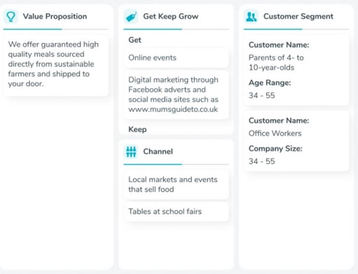
Business Model Canvas – Desirability

Slide 24
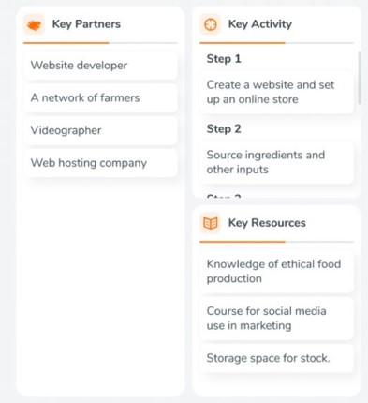
Business Model Canvas – Feasibility

Slide 25
Business Model Canvas – Viability

Slide 26
Sim Venture Validate Process
Ideate.
Create.
Test and Refine.
Produce and Share.
Notes:
Ideation - come to the platform with your own idea or be inspired by problems and solutions to develop new ideas.
Create - map out your idea against 10 building blocks.
Test and Refine - undertake tests to validate hypothesis, update results and refine your business model.
Produce and Share - finalise and personalise portfolio to evidence your findings.

Slide 27
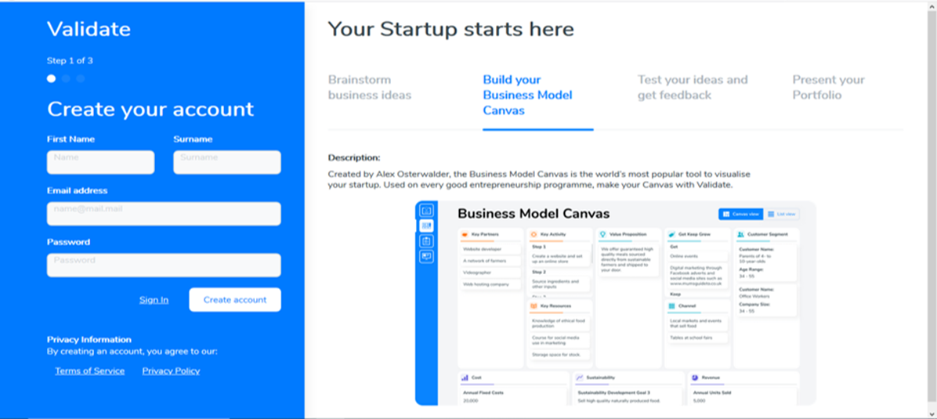
1. Create Your Account on Sim Venture Validate

Slide 28
2. Name Your First Project

Slide 29
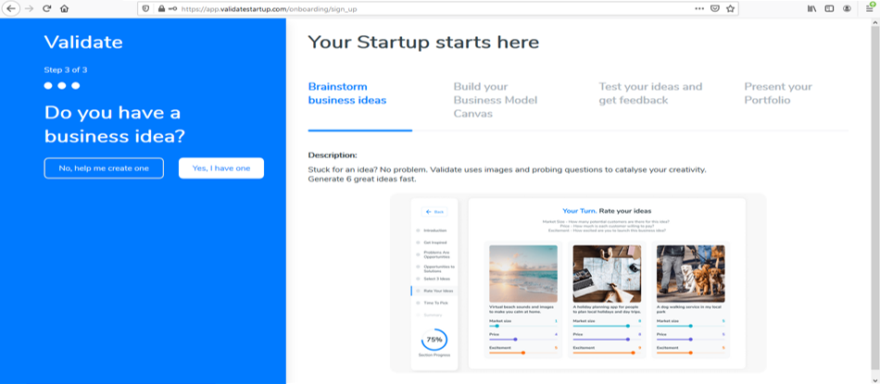
3. Generate a Business Idea

Slide 30
Six Steps to Generate Business Ideas
Pick 6 images that inspire you.
Use the 6 images to come up with 6 problems.
Come up with 6 business ideas to solve these problems.
From these 6 ideas, select your top 3.
Rate these 3 ideas against each other.
Select the idea that you want to take forward.
Notes:
Get Inspired – pick 6 images that inspire you.
Problems are Opportunities – use the 6 images to come up with 6 problems.
Opportunities to Solutions –Come up with 6 business ideas to solve the problems you’ve identified.
Select 3 Ideas – from these 6 ideas, select your top 3.
Rate Your Ideas – rate these 3 ideas against each other.
Time To Pick – select the idea that you want to take forward.

Slide 31
Key Takeaways
Businesses often emerge as solutions to problems in the market.
Business ideas can come from many sources, including existing businesses, networking & hobbies.
A good idea is not necessarily a good opportunity.
Notes:
There are many ways to generate business ideas, including direct search for opportunities and finding solutions to problems in the market.
Business ideas can stem from many sources such as existing businesses, networking, work experience, hobbies and travel.
A good idea is not necessarily a good business opportunity.

