Slide 1
Customer Segmentation
Lecture 3

Slide 2
Table of Contents 1 of 3
Learning Objectives
Quote by Philip Kotler
Case Study Example – Cross Pens
Business Model Canvas – Desirability
Business Model Canvas – Feasibility
Business Model Canvas – Viability

Slide 3
Table of Contents 2 of 3
Questions on Customer Segmentation
Approaches to Customer Segmentation
Ways to Segment by Demographics
Ways to Segment by Geographics
Ways to Segment by Psychographics
Ways to Segment by Behaviours

Slide 4
Table of Contents 3 of 3
Benefits of Market Segmentation
Video Explainer – STP Marketing
Sim Venture Validate – Define Your Customer in 4 Steps
Persona Exercise 1 of 2
Persona Exercise 2 of 2
Key Takeaways

Slide 5
Learning Objectives
Understand methods for segmenting a market.
Know the benefits of segmenting.
Identify a target segment for your business idea.
Develop a persona to visualise your target customer.
Notes:
Understand the methods for segmenting a market.
Appreciate the benefits of segmenting the market.
Identify a target segment for your business idea.
Develop a persona to help you to visualise your target customer.

Slide 6
Quote by Philip Kotler

Slide 7
Case Study Example – Cross Pens

Slide 8
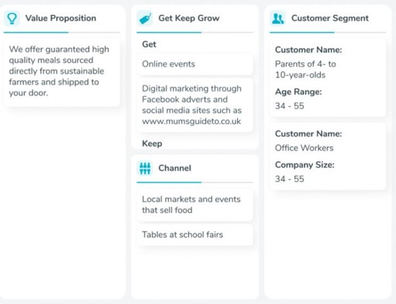
Business Model Canvas – Desirability

Slide 9
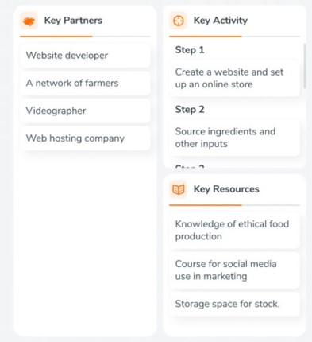
Business Model Canvas – Feasibility

Slide 10
Business Model Canvas – Viability

Slide 11
Questions on Customer Segmentation
For whom are you creating value?
Who are your most important customers?

Slide 12
Approaches to Customer Segmentation
Mass Market.
Niche Market.
Segmented.
Diversified.
Multi-sided platforms.
Notes:
Mass market – no distinction between segments
Niche market –specific, specialized segments
Segmented – segments with slightly different needs and problems
Diversified – two or more unrelated segments with very different needs and problems
Multi-sided platforms – two or more interdependent segments

Slide 13
Ways to Segment by Demographics
Age & gender.
Income.
Level of education.
Religion.
Occupation.
Social Status.
Family.
Life Stage.

Slide 14
Ways to Segment by Geographics
Climate.
Culture.
Language.
Population Density.
Country.
City.

Slide 15
Ways to Segment by Psychographics
Personality.
Hobbies.
Opinions.
Life Goals.
Values and beliefs.
Lifestyle.
Attitudes.

Slide 16
Ways to Segment by Behaviours
Spending Habits.
Purchasing Habits.
Occasion.
Buyer Stage.
Loyalty to your Brand.
Product Feedback.
Usage.
Benefits Sought.

Slide 17
Benefits of Market Segmentation
Focus on the customers that matter most.
Power new product development.
Design more effective marketing.
Deliver better customer service.
Use your resources more efficiently.
Develop a more customer centric culture.
Create a superior experience for customers.
Notes:
Focus on the customers that matter most.
Power new product development.
Design more effective marketing.
Deliver better customer service.
Use your resources more efficiently.
Develop a more customer centric culture.
Create a superior experience for customers.

Slide 18
Video Explainer – STP Marketing Source: Expert Program Management, Youtube
Notes:
https://youtu.be/iGOw39GWDaI?si=4TsZblMIIpj5BFYQ

Slide 19
Sim Venture Validate – Define Your Customer in 4 Steps
1. What is the name of the Customer Segment?
2. What type of segment is this (B2B, B2C)?
3. Provide customer age or company size.
4. Describe 3 customers.

Slide 20
Persona Exercise 1 of 2
List the key terms to describe your target customer.
For example: 18-24 year old, female, Irish, university student.
Use Google Image to select an image that best represents your target audience.
Notes:
List the key terms that you would use to describe the person that you are targeting with your product / service (e.g. 18-24 year old, female, Irish, university student).
Use Google Image to select an image that best represents your target audience.

Slide 21
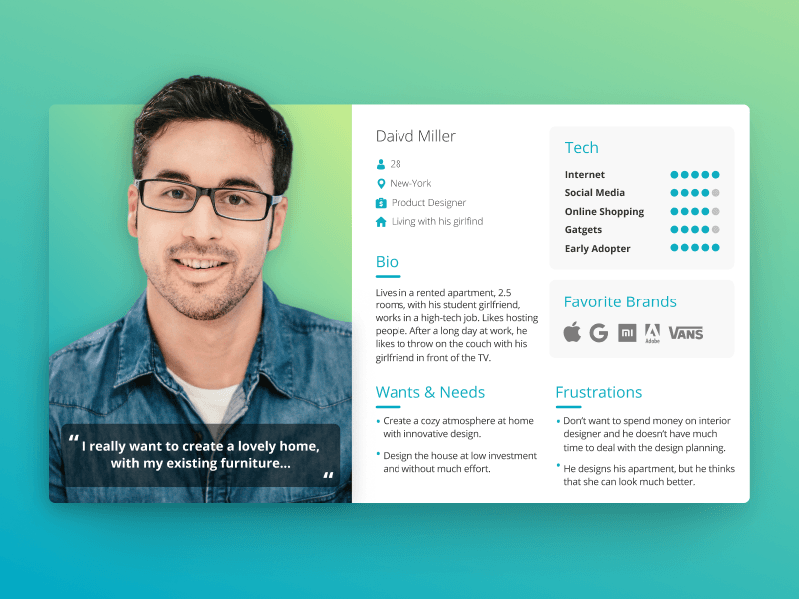
Persona Exercise 2 of 2
Find other images to represent their:
Habits & interests,
Desires,
Fears & pain points.
Create a portfolio of images of your target customer.
Add your preferred image to Sim Venture Validate.
Notes:
Find other images to represent their habits, interests, fears, desires, pain points, passions, etc.
Create a portfolio of images that accurately portrays your target customer.
Add your preferred image to Sim Venture Validate.

Slide 22
Key Takeaways
Your product / service cannot target everybody.
Identify a specific customer segment that you can lead.
Develop a persona that accurately portrays your target customer.
Develop a persona to visualise your target customer.
Notes:
Your product / service cannot target everybody.
Identify a specific customer segment that you can lead.
Develop a persona that accurately portrays your target customer.
Please complete the section on Customer Segments on Validate before class next week.

