Slide 1
Financial Literacy
Lecture 9

Slide 2
Table of Contents 1 of 3
Learning Objectives.
Five Blocks of Finance – REAL_E.
Financial Statements.
Profit and Loss Account.
Important Points 1.
Important Points 2.

Slide 3
Table of Contents 2 of 3
Balance Sheet.
Important Terms 1 - Capital Expenditure.
Important Terms 2.
Important Terms 3 – Liabilities.
Important Terms 4 – Equity (Owners’ Funds).
List of Potential Costs.

Slide 4
Table of Contents 3 of 3
How to Generate Profit – Increase Sales.
How to Generate Profit – Reduce Material Costs.
How to Generate Profit – Reduce Labour Costs.
How to Generate Profit – Reduce Overhead Costs.
Sources of Finance.
Considerations for Investors.
Considerations for Lenders.
Key Takeaways.

Slide 5
Learning Objectives
Introduce the basic terms of finance.
Explain the requirements for financial projections.
Detail the different sources of finance and the considerations for funders.
Notes:
Introduce you to the basic terms of finance.
Explain the requirements for financial projections.
Detail the different sources of finance and the considerations for funders.

Slide 6
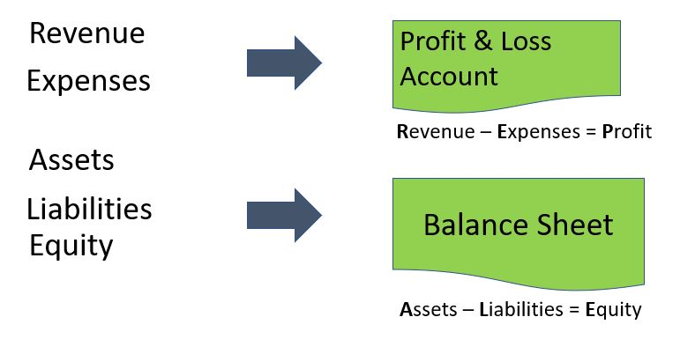
Five Blocks of Finance – REAL_E

Slide 7
Financial Statements
Cash Flow (cash in and out every month).
Profit and Loss account (how much profit / loss you made last year).
Balance Sheet (statement of overall value of the company).
Notes:
Cash Flow (cash in and out every month)
Profit and Loss account (how much profit / loss you made last year)
Balance Sheet (statement of overall value of the company)

Slide 8
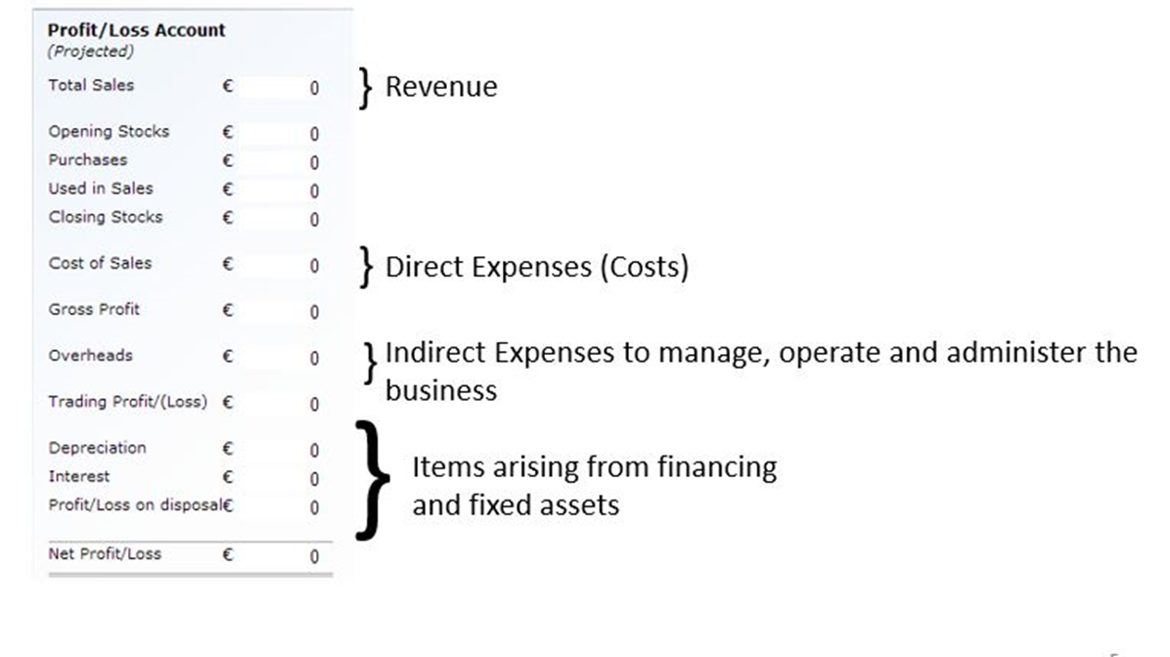
Profit and Loss Account

Slide 9
Important Points 1
Profit and cash are not the same.
Invoiced sales, purchases and expenses will impact the P&L, but won‘t affect cashfow until they are settled or paid.
Amortization is the method that is used to decrease the cost of the asset over time.
Depreciation is the loss in value of the asset over time.
Notes:
Profit and cash are not the same.
Invoiced sales, purchases and expenses will impact the P&L, but won‘t affect cashfow until they are settled (paid).
Amortization is the method that is used to decrease the cost of the asset over time, while depreciation is the loss in value of the asset over time.
Depreciation and amortisation impact on the P&L, but not cashflow.
Capital receipts (new share capital and loans) impact cashflow, but not the P&L.
Capital payments (fixed assets, loan principal repayments) impact cashflow, but not the P&L.

Slide 10
Important Points 2
Depreciation and amortisation impact on the P&L, but not cashflow.
Capital receipts, including new share capital and loans, impact cashflow, but not the P&L.
Capital payments, including fixed assets, loan principal repayments, impact cashflow, but not the P&L.
Notes:
Profit and cash are not the same.
Invoiced sales, purchases and expenses will impact the P&L, but won‘t affect cashfow until they are settled (paid).
Amortization is the method that is used to decrease the cost of the asset over time, while depreciation is the loss in value of the asset over time.
Depreciation and amortisation impact on the P&L, but not cashflow.
Capital receipts (new share capital and loans) impact cashflow, but not the P&L.
Capital payments (fixed assets, loan principal repayments) impact cashflow, but not the P&L.

Slide 11
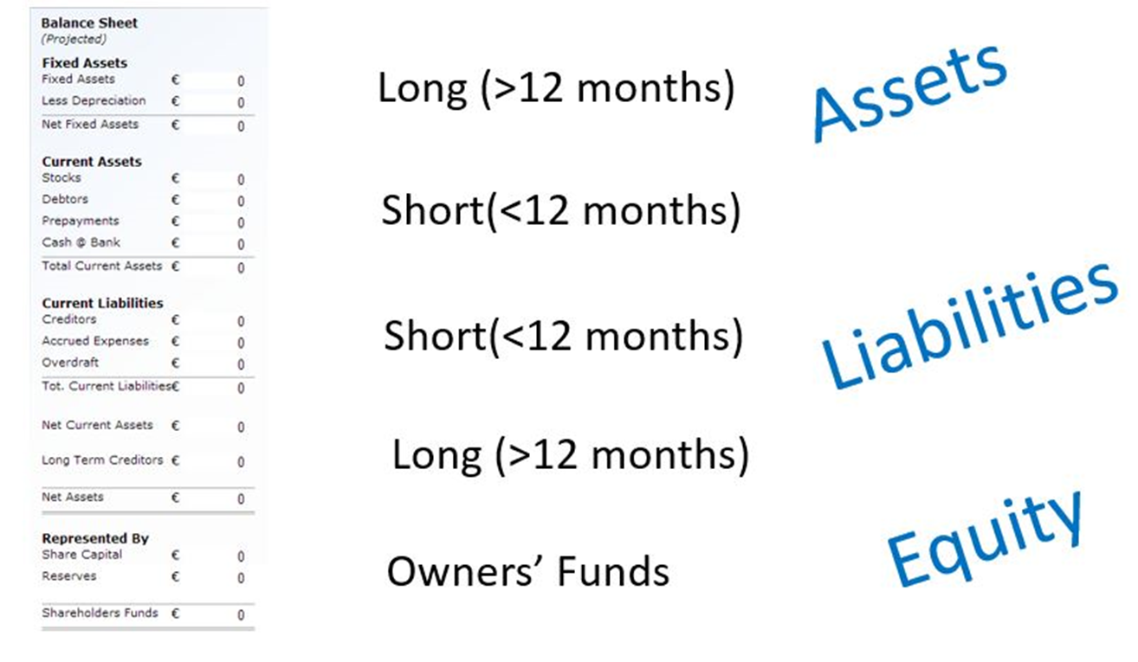
Balance Sheet

Slide 12
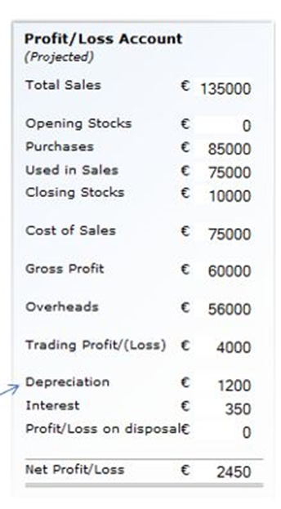
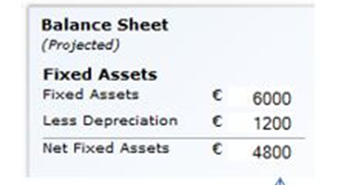
Important Terms 1 - Capital Expenditure
Capital expenditure refers to material expenditure on fixed assets.
The values will appear on the balance sheet and be charged to the P&L over the useful life of the asset in the form of depreciation or amoritisation.

Slide 13
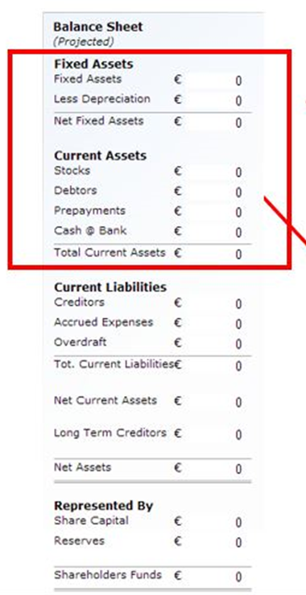
Important Terms 2
Revenue expenditure is repetitive expenditure on day to day items such as wages, goods for resale and overheads.
Assets are items owned by a business:
To generate sales and hence profits (fixed assets such as premises, plant, vehicles) or
To convert into cash (a current asset such as debtors and stocks).

Slide 14
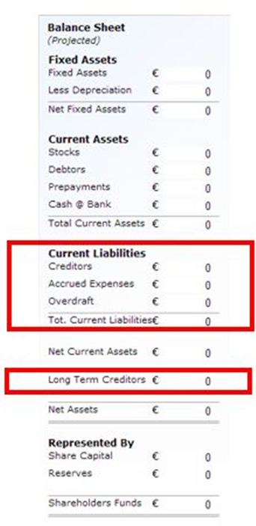
Important Terms 3 – Liabilities
Liabilities are the funds provided to the business by way of loans, credit and deferred payments i.e. what it owes.
Current liabilities are the amounts to be settled within the next 12 months.
Long-term or non-current refers to amounts that will remain outstanding after 12 months.

Slide 15
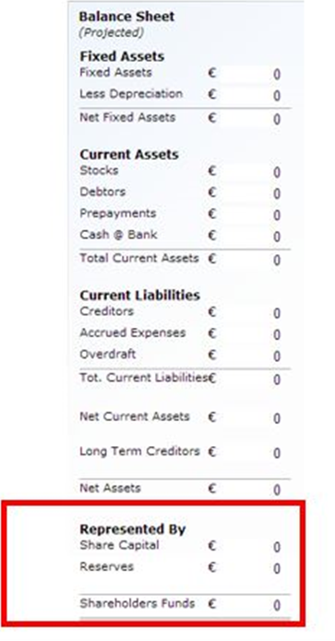
Important Terms 4 – Equity (Owners’ Funds)
Equity refers to the surplus of assets over liabilities (net assets) and belongs to the owners.
It is also referred to as the “Net Worth” of the business or the “Owner’s Funds”.

Slide 16
List of Potential Costs
Property/Rent
Renovations
Fixtures and Fittings
Transport
Machines and Equipment
Stock/Supplies
Salaries/Wages
Selling and Promotion
Loan repayments
Taxes/VAT
Legal costs (incorporation)
Subscriptions
Depreciation
Fuel
Travel
Telephone
Postage
Subscription
Stationary
Computer supplies/IT

Slide 17
How to Generate Profit – Increase Sales
Strategy: Increased selling prices and/or volumes of sales.
Tactics:
Winners and losers (mix).
Design & development.
Develop new markets.
Expand current markets.
Promotion & advertising.
Sales control systems to reduce unnecessary discounting, unrecorded sales, etc.

Slide 18
How to Generate Profit – Reduce Material Costs
Strategy: Lower prices paid and/or more effective utilisation.
Tactics:
Eliminating or reducing materials by redesigning products/services.
Substituting cheaper materials which still maintain required quality standards.
Finding better suppliers.
Negotiating better prices and discounts.
Purchase control systems to avoid overpayments.

Slide 19
How to Generate Profit – Reduce Labour Costs
Strategy: Lower rates and/or increased productivity.
Tactics:
Negotiating wage/salary cuts.
Better planning to avoid idle time.
Improving work practices and methods.
Tools/technology to improve productivity.

Slide 20
How to Generate Profit – Reduce Overhead Costs
Strategy: Prices paid and/or increased utilisation.
Tactics:
Other suppliers.
Changes in place and practice to reduce insurance.
More “cost aware” work practices.
Volatile work items. For example, travel expenses and phone bills.
Internal controls to ensure expenses don’t creep up.

Slide 21
Sources of Finance
Owner Funds (own money).
Bootstrapping.
Debt.
Business Angels.
Venture Capitalists.
Grants / Soft Loans.

Slide 22
Considerations for Investors
How much money do you want?
Equity stake / ownership.
Expected return on investment.
Timing.
Exit strategy.
Notes:
Investors
How much money do you want?
Equity stake / ownership
Expected return on investment
Timing
Exit strategy

Slide 23
Considerations for Lenders
Security.
Ability to repay loan.
Schedule of payments.
Owners’ equity.
Credit history.
Notes:
Lenders
Security
Ability to repay loan
Schedule of payments
Owners’ equity
Credit history

Slide 24
Key Takeaways
The five building blocks of finance are:
Revenue,
Expenses,
Assets,
Liabilities and
Equity.
Three financial statements:
Profit & Loss Account.
Balance Sheet.
Cashflow Statement.
Notes:
There are five building blocks of finance captured by the REAL_E acronym. These are Revenue, Expenses, Assets, Liabilities and Equity.
There are three financial statements that every business must have. These are Profit & Loss Account, Balance Sheet and Cashflow Statement.
There are multiple ways of funding your business, including own funds, bootstrapping, debt financing and equity financing.

