Slide 2
Peer to Peer Finance
Based on the simple principle of cutting out the middleman – the bank
Those who have money get it to those who need it

Slide 3
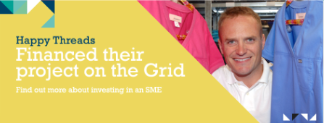
The GRID

Slide 4
HAPPY THREADS
RH
DISTRIBUTION
Notes:
Quality of the training and experience from firm– immense. Arms you to take on any challenge
The world we live in is complex, with no quick fixes to some of the biggest problems and challenges we face
People People People
We can’t be afraid of taking on those big challenges – change is generational, change is about real people on the ground – change will happen by mobilizing those incredible people who often feel like they have no voice, no role to play – What change will we see in our generation, what change will we seek?
Professionalism
People
Diversity of client work and getting into the detail

Slide 7
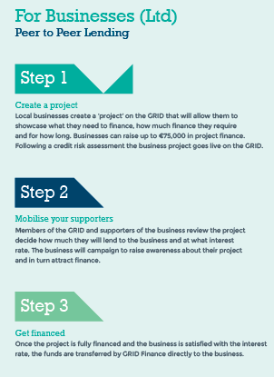
The Process

Slide 8
Type of funding
Type of company:
Limited
Sole Traders
Proven cashflow
Clear ability to repay
Product for start-ups upcoming
Type of lending
3-36 months
Ideally asset focused with clear ROI
Must have a specific need for funds

Slide 9
What we need from our business customers
Management accounts/Financial statements
Project budget
3 months bank statements
External credit score
ICB report (sole traders)

Slide 10
Costs
2% of project funding
Annual membership fee – currently waived

Slide 11
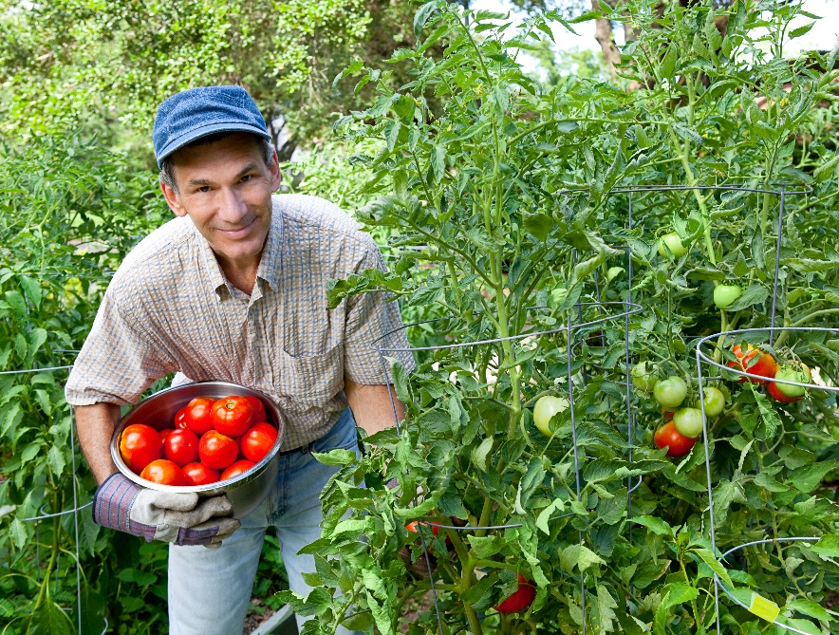
Why use the GRID?
Quick
Cheap
Engage your
customers
Discretionary PG
Flexible

Slide 12
Get on the GRID now!

