Slide 2
Our Vision! More start-ups, more business and more jobs locally.

Slide 3
Our Clients
The Local Enterprise Office is for people interested in starting up a new business or already in business including; entrepreneurs, early stage promoters, start-ups and micro and small business looking to expand.

Slide 4
First Stop Shop
We are the First Stop Shop for anyone seeking information and support on starting or growing a business in Ireland.
Our dedicated team deliver a wide range of supports and services.

Slide 5
Our Role
To drive the development of local enterprise, putting local micro and small business at the heart of job creation in Ireland.
To drive and support business start-ups and promote a ‘can-do’ business culture.
To increase the job potential of new and existing micro and small businesses.
To increase the number of innovative businesses with potential to export.
To be proactive in response to the needs of our clients.

Slide 6
Business Advice Clinic

Slide 7
Overview
Your Business Idea
Business Plan
Business Types
Sources of Finance
Training
Mentoring
Business Support Information

Slide 8
1. Your Business Idea

Slide 9
Problem
What problem are you solving?
What alternatives are people using right now
Solution
Outline your Solution
Needs to be something people Want, and will Pay for
Customer Segment
Describe your target customer
Distinguish between “user” and “customer”
Customer pays for your product, user does not

Slide 10
Unique Value Proposition (UVP)
Why are you different?
Focus on Benefits...not Features
No.1 problem you are solving
Why choose you?
Dominos Pizza: "You get fresh, hot pizza delivered to your door in 30 minutes or less, or it's free.”
FedEx: When it absolutely, positively has to be there overnight. (Signifies speed)

Slide 11
Channels to Market
Inbound: Website, Blogs, Facebook page, Video etc
Outbound: Print ads, Trade shows, Cold calling, Networking, Develop strategic alliances
Revenue Streams
Decide on payment model, margins
Cost Structures
Development costs, prototype development, premises, IT, labour etc

Slide 12
2. Business Plan

Slide 13
A Roadmap for your business
Will change and evolve as your business grows
Essential when looking for financial support

Slide 14
Typical Structure
Executive Summary
Introduction
Market
Market Strategy
Organisation and Management
Production and Operations
Costs and Finance
Financial Statement
Sample Business Plans
www.localenterprise.ie/DublinCity/Publications-Resources/Sample-Business-Plans

Slide 15
3. Business Types

Slide 16
Types of Business
Sole Trader
Partnership
Limited Company
Important Websites
Companies Registration Office (CRO) www.cro.ie
Revenue (Tax Office) www.revenue.ie/en/Home.aspx

Slide 17
Sole Trader
Advantages
Most appropriate and easy route when setting up
No annual audit required
Easy to wind up and turn business into limited company at later date
Fewer legal formalities and compliance requirements
Disadvantages
Taxed at individual rates - can deduct for expenses
Personal Liability for losses of the business
Creditors entitled to personal possessions
Not a separate legal entity

Slide 18
Obligations
Legally obliged to register the name IF trading name is not carried on under his/her own name. Register with CRO, €40 for paper filing/€20 for electronic filing
Obliged to register as a Sole Trader for central tax purposes with Revenue
Maintain proper bookkeeping and accounts records
Register for VAT when
Annual sales turnover exceeds €37,500 for Services, €75,000 for Products
Register as an employer if employees are hired and operate a payroll for such employees

Slide 19
Partnership
Advantages
Most appropriate and easy route when setting up
No annual audit required
Easy to wind up and turn business into limited company at later date
Fewer legal formalities and compliance requirements
Disadvantages
Taxed at individual rates - can deduct for expenses
All partners are liable without limit for all the debts of the firm
Creditors entitled to personal possessions
Not a separate legal entity

Slide 20
Obligations
Generally same as a Sole Trader
Written Partnership Agreement crucial
If none, subject to Partnership Act 1890
Not practical for modern business - No right to remove partner, any partner may end partnership etc
Limited Partnership: where some members have limited liability for the debts of the firm. Individual invests in business but takes no role in day to day operations

Slide 21
Limited Company
Advantages
Business is seen as separate legal entity
Limited Liability: linked to the amount paid for shares
Low corporation tax rate of 12.5%
Easier to raise capital to fund growth and development
Greater ability to raise finance by the issue of shares
Disadvantages
Higher costs to opening and closing the business
Accounts must be filed annually with CRO, who will then publish the accounts

Slide 22
Obligations
Must be registered with CRO
Keep adequate accounting records
Prepare annual financial statements
Wide range of Director’s responsibilities www.odce.ie/Portals/0/Directors.pdf
Duties of Company Secretary www.odce.ie/Portals/0/Secretaries.pdf

Slide 23
Types of Limited Company
Company Limited by Shares (CLS)
Most popular option
One director AND a separate company secretary (CLS)
One document constitution replaces need for Memorandum and Articles
Designated Activity Company (DAC)
Suitable for Charities, Management Companies, Guarantee Companies & companies incorporated for a specific purpose
Public Limited Company (PLC)
Seeking a listing on stock exchange

Slide 24
4. Sources of Funding

Slide 25
Local Enterprise Office Dublin City
Types of Grants
Feasibility Grant
Priming Grant
Business Expansion Grant
Trading Online Voucher
Technical Assistance for Micro Exporters
Innovation Voucher
Eligibility Criteria
1 - 10 employees that are Dublin City Council area
Not getting financial support anywhere else
Must be:
Manufacturing,
Internationally traded service or
Business with potential for overseas customers (not retail, trade or professional service)

Slide 26
Feasibility Grant
To assist the promoter with researching market demand for a product or service and examining its sustainability
For innovative concepts not already on the market
Covers 50% of spend towards 3rd party market research consultancy and/or prototype development costs
Max €15k
Priming Grant
For businesses trading < 18 months
Must include 1 new Full Time job
Eligible costs - Salary (up to €10k per job)
Max €50k

Slide 27
Business Expansion Grant
For businesses trading > 18 months
Must include 1 new Full Time job
Eligible costs – Salary
Max €80k, portion refundable

Slide 28
Application Process
Complete the Business Support Request Form online www.localenterprise.ie/dublincity
Following discussion with our Business Advisor and if your business is deemed eligible for application for grant financial assistance, you will then submit a formal application
Your formal application for grant financial assistance will be reviewed internally and if deemed ready will progress to our independent Evaluation & Approvals Committee (EVAC) for review and a decision will be made
If approved, a letter of offer/contract is issued

Slide 29
Trading Online Voucher
Website development (ecommerce, SEO, booking system, advertising etc)
Must be trading for 6 months
Covers 50% of spend up to €2,500
www.localenterprise.ie/DublinCity/Financial-Supports/Types-of-Grants/Trading-Online-Voucher
Technical Assistance for Micro
Exporters (TAME)
To exhibit at overseas trade shows
Travel, accommodation, logistics etc
50% of costs, up to €2,500
www.localenterprise.ie/DublinCity/Financial-Supports/Technical-Assistance-for-Micro-Exporters

Slide 30
Innovation Voucher
Assist a company to explore a business opportunity or problem with a registered
Knowledge provider (Education Institute)
Max €5k
www.localenterprise.ie/DublinCity/Financial-Supports/Other-Capital-Options/Innovation-Vouchers/Innovation-Vouchers.html

Slide 31
Microfinance Ireland (MFI)
Loans up to €25k to newly established or growing microenterprises, with commercially viable proposals
Eligibility:
< than 10 staff
Turnover / or balance sheet less than €2m
May be a start up OR an existing business
Apply through LEO and get 1% reduction in interest (6.8%)
Need to have a realistic business plan including cashflow projections
Proven business model with prospect of near term cash flow
Number of new jobs and social impact taken into account
See www.microfinanceireland.ie for more info

Slide 32
SURE Scheme
SURE is a tax refund scheme
You may be entitled to an income tax refund of up to 41% of the capital that you invest under SURE
Depending on the size of investment, you may be entitled to a refund of PAYE income tax that you paid over the six years before the year in which you invest
More info:
www.sure.gov.ie/Home
www.revenue.ie/en/tax-professionals/tdm/income-tax-capital-gains-tax-corporation-tax/part-16/16-00-11.pdf
SUREadmin@revenue.ie

Slide 33
Department of Social Protection
Back to Work Enterprise Allowance
When setting up a business you can keep % of social welfare allowance for up to 2 years (1st year 100%, 2nd year, 75%)
Short-Term Enterprise Allowance (STEA)
On Job Seekers benefit
Start your own business and receive allowance instead of Jobseekers Benefit for max 9 months
Enterprise Support Grant
Up to €2,500 over 2 years (tools, IT, equipment etc)

Slide 34
JobsPlus
Designed to encourage and reward
employers who offer employment opportunities to the long term unemployed
Recruit someone who is:
more than 12 months but less than 24 months unemployed: €7,500
more than 24 months unemployed: €10,000
Payable monthly in arrears, over a two year
period – while employee retained
Jobs must be ‘full-time’, at least 30 hours per week (p/w) spanning at least four days p/w
See www.welfare.ie/en/Pages/jobsplus.aspx/ for more details

Slide 35
Crowdfunding
Funding a project or venture by raising money via the Internet from a large number of people who each contribute a relatively small amount.
Rewards based
Kickstarter
Fund it
Crowd Lending (P2PLending)
Linked Finance
Grid

Slide 36
Other Sources
Yourself
Family & Friends
Grants/Loans
Banks/Credit Unions/Venture Capitalists
Investment
Business Angels
More info:
www.localenterprise.ie/DublinCity/Financial-Supports/Other-Capital-Options/

Slide 37
5. Training

Slide 38
Local Enterprise Office Dublin City Training
Start Your Own Business Programme
Social Media
Digital Marketing
Creating a Website
Bookkeeping
Tax
Sales

Slide 39
Food Programmes
Digital School of Food www.digitalschooloffood.ie
Free learning hub has been designed to support you in developing your food manufacturing businesses from start-up to the growth phase
Food Starter Programme
Short two day programme designed to help those with a food idea or at very early stage of starting up a food business
Food Academy Start Programme
(LEO, Bord Bia & SuperValu)
Extensive training programme aimed at supporting and nurturing start-up food businesses

Slide 40
Craft Programmes
Building Craft and Enterprise Design
A seven month training programme run in partnership with the Design and Crafts Council of Ireland (DCCoI) to help ambitious craft & design entrepreneurs who want to inject new ideas and approaches to product development into their practice

Slide 41
Management Development Programmes
Hi-Start
Assists ambitious early stage growth focused companies to identify and build foundations required to secure investment and scale the business in international markets
Plato
A not for profit business development programme that helps SMEs grow their business in a planned way.
Lean for Micro
Introduction to lean concepts and practical understanding of lean principles
Accelerate
Provides the owner/manager with the management, leadership, business skills and knowledge to achieve sustainability and growth

Slide 42
How to Apply
Visit www.localenterprise.ie/DublinCity/Training-Events/
Pick the course that suits you best
Pay online with a Credit/Debit card

Slide 43
Springboard Training
Free courses at certificate, degree and
masters level leading to qualifications in areas
where there are employment opportunities
in the economy
www.springboardcourses.ie

Slide 44
6. Mentoring

Slide 45
We can provide individuals/companies with temporary advisers who will help you develop your business
Available to businesses based in the Dublin City area e.g. Dublin 1 -13, 17 & 20
Have less than 10 employees

Slide 46
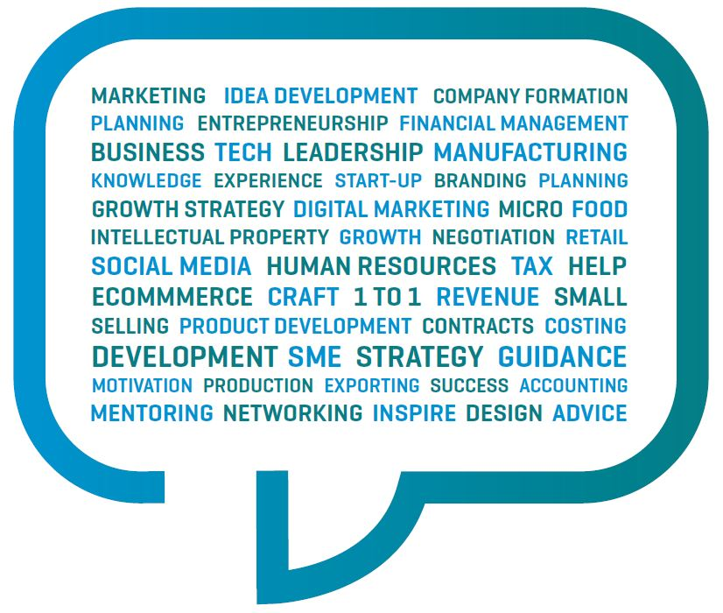
We have the following mentoring options available:
3 hour (€50)
6 hour (€100)
Apply via our website www.localenterprise.ie/DublinCity/Start-or-Grow-your-Business/Mentoring-Business-Advice/

Slide 47
7. Business Support Information

Slide 48
Agencies
Bord Bia www.bordbia.ie
Irish Food Board
Dedicated website for start ups in food production www.bordbiavantage.ie
Market Information Department: a library of research and leading-edge marketing literature available to all food businesses
Failte Ireland www.failteireland.ie
National Tourism Development Authority of Ireland
Tourism Marketing
Training Services
Product Development
Market Research

Slide 49
Enterprise Ireland
www.enterprise-ireland.com
Responsible for the development and growth of Irish enterprises in world markets
Focus on global markets, export sales, job creation, product /service innovation
New Frontiers Entrepreneur
Development Programme
Funding:
High Potential Start-Up (HPSU) - for businesses with international markets & potential to create 10 jobs, €1M in sales in 3-4 years
Range of other financial supports depending on stage of the business

Slide 50
National Digital Research
Centre (NDRC) www.ndrc.ie
Digital start ups
Cash investment, mentorship, helping business to become “Investor Ready”

Slide 51
Arts Council
www.artscouncil.ie
National agency for funding promoting and developing the arts in Ireland
Irish Film Board www.irishfilmboard.ie
Development agency for the Irish film, television and animation industry

Slide 52
Patents, Trademarks & Copyright
Trademarks
The means by which a business identifies its goods or services and distinguishes them from the goods and services supplied by other businesses.
May consist of words, (including personal names), designs, logos, letters, numerals
Trademark searching - use TM View and/or eSearch plus on website
Avoid descriptive, laudatory or geographic words to use as trade marks
Initial Application: €70, if successful
Registration fee of €177 applies
Renewal fee: €250 every 10 years

Slide 53
Patent
The right to exclude others from exploiting (making, using, selling, importing) the patented invention, except with the consent of the owner of the patent.
3 essentials for seeking a patent; the invention must be new, no public exposure, have an inventive step
Fees: Can vary substantially- depends on region, type etc.
www.patentsoffice.ie/en/Patents/Statutory-Patent-Fees
Copyright
Describes the rights given to authors/creators of certain categories of work
Owner is the author, meaning the person who creates the work. The act of creating a work also creates the copyright
Copyright protection usually expires 70 years after the death of the author/creator

Slide 54
Useful Websites
ThinkBusiness www.thinkbusiness.ie
Tools, templates, guides, checklists, case studies
All business functions covered – marketing, planning, financials etc
Food Safety Authority of Ireland (FSAI)
www.fsai.ie/food_businesses.html
All you need to know if starting a Food Business
SupportingSMEs
www.supportingsmes.ie/BusinessDetails.aspx
Great guide to navigate over 170 different Government supports for Irish start-ups and small businesses.

Slide 55
Social Entrepreneurship Supports
Social Entrepreneurs in Ireland www.socialentrepreneurs.ie
Guidance, mentoring, funding
Social Enterprise Network
www.socent.ie
Community Loan Finance
www.clanncredo.ie

Slide 56
Networks
LEO Dublin City Women in Business
https://www.localenterprise.ie/DublinCity/Start-or
Grow-your-Business/Networking/Women-in
Business
Encourage and support women who are starting business or are already up and running
Dublin Food Chain www.dublinfoodchain.ie
Marketing and networking forum representing food and drink producers, retailers, and distributors based throughout Dublin
PLATO Dublin www.platodublin.ie
Management development programme for existing business owners
Dublin Chamber www.dubchamber.ie
Connecting Dublin based businesses networking, advice, export services, workshops

Slide 57
Enterprise Europe Network
www.een-ireland.ie
Helping Irish businesses with international growth and innovation
Services
Develop business in new markets,
Source or license new technologies
Comprehensive innovation support and business advice
Find the right partners - manufacturing, distribution, research & development

Slide 58
Incubation Centres / Co-working Spaces
Guinness Enterprise Centre www.gec.ie
Spade Enterprise Centre www.spade.ie
Docklands Innovation Park
www.docklandsinnovation.ie
Liffey Trust www.liffeytrust.ie/Liffey-Trust
Terenure Enterprise Centre www.terenureenterprise.ie
Digital Hub Development Agency www.thedigitalhub.com
Ballymun Enterprise Centre www.dcebenterpriseguide.com/directory/ballymun-enterprise-centre
Inner City Enterprise www.innercityenterprise.com
Northside Enterprise Centre www.nec.ie

Slide 59
Stay in Touch
Keep up to date on all our supports and services by subscribing to our newsletter http://bit.ly/LEODublinCityNews
Facebook: www.facebook.com/LEODublinCity
Twitter: @LEODublinCity
LEO Dublin City YouTube Channel www.youtube.com/channel/UChD5pnX_Y9KBb3afGrZibRw?view_as=subscriber

Slide 60
Contact Us
Local Enterprise Office Dublin City
Block 1, Floor 4, Civic Offices, Wood Quay, Dublin 8
Tel: 01 222 5611
Email: info@leo.dublincity.ie
Website: www.localenterprise.ie/DublinCity

